Slide 1

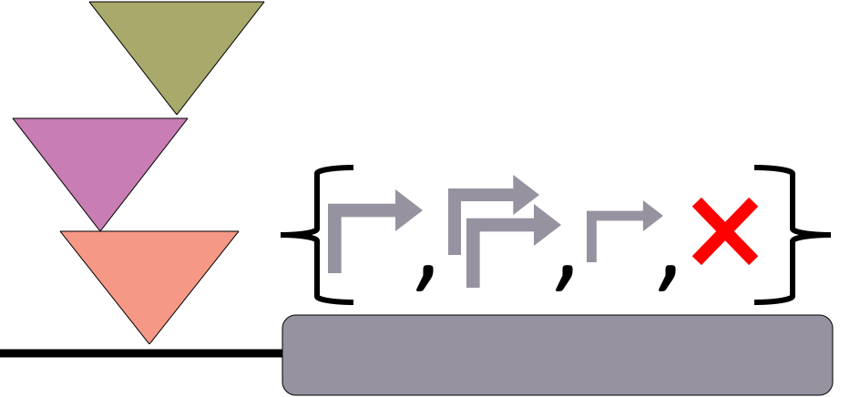

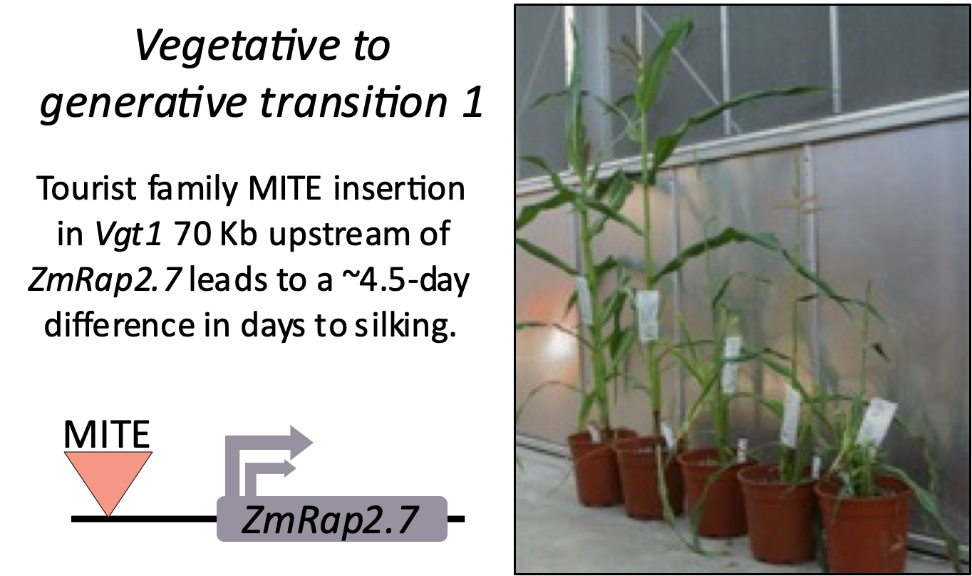
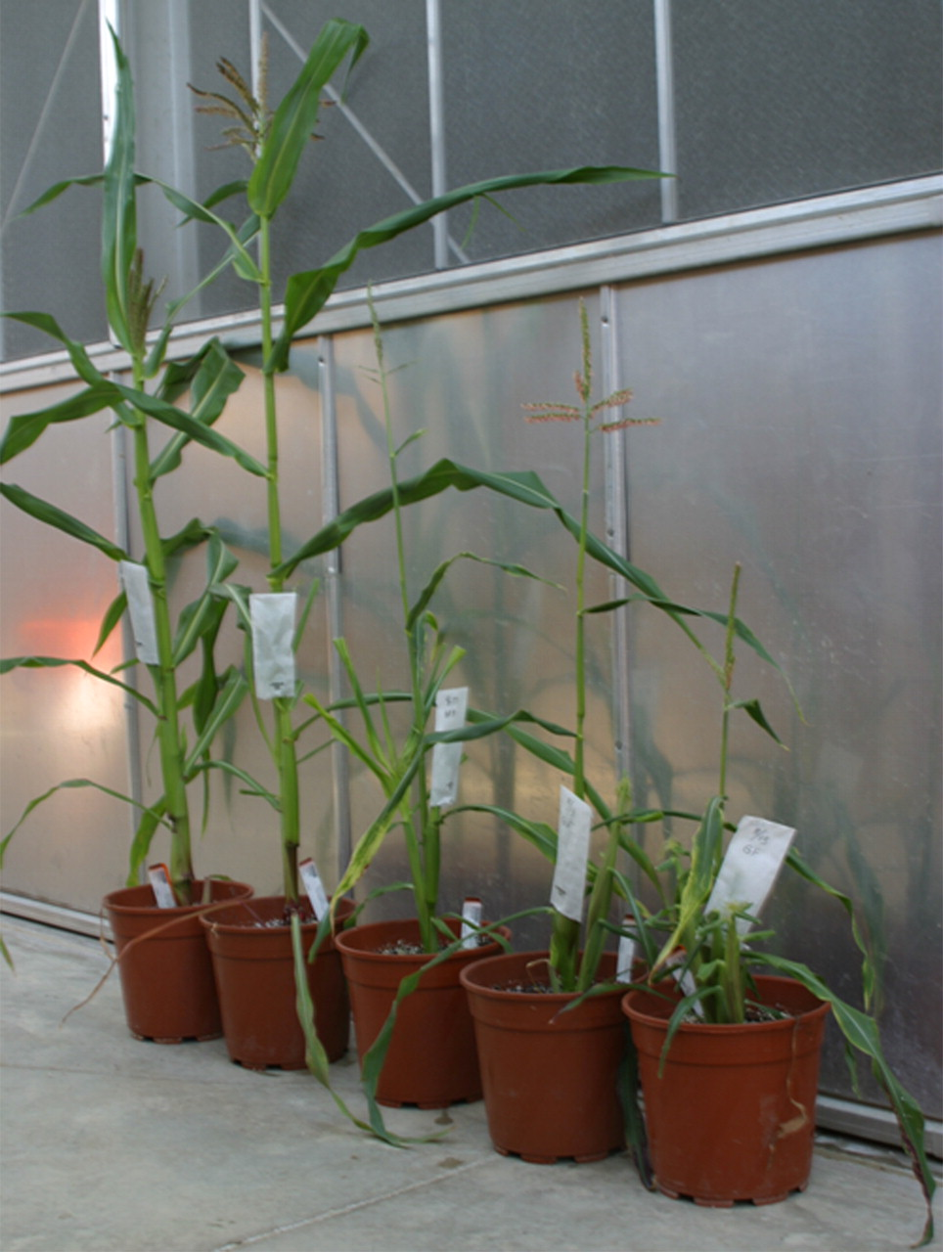
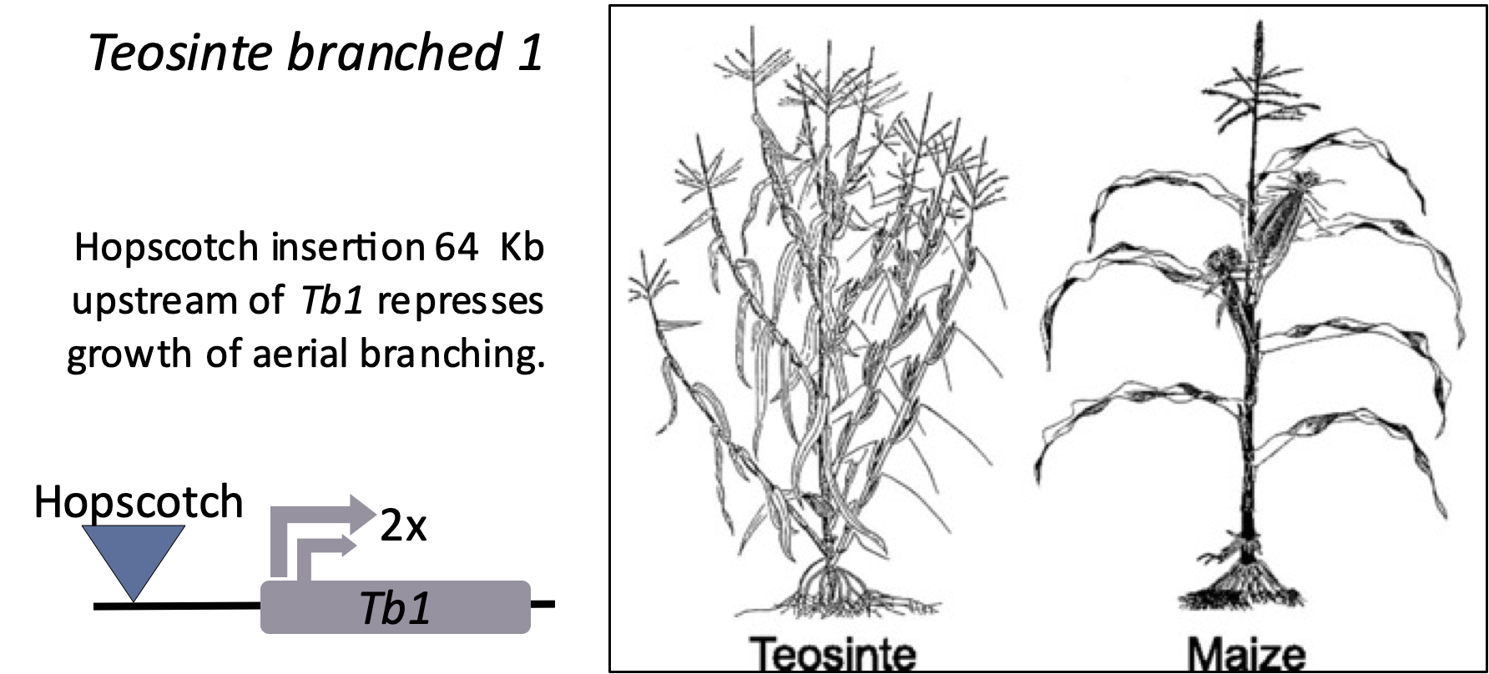
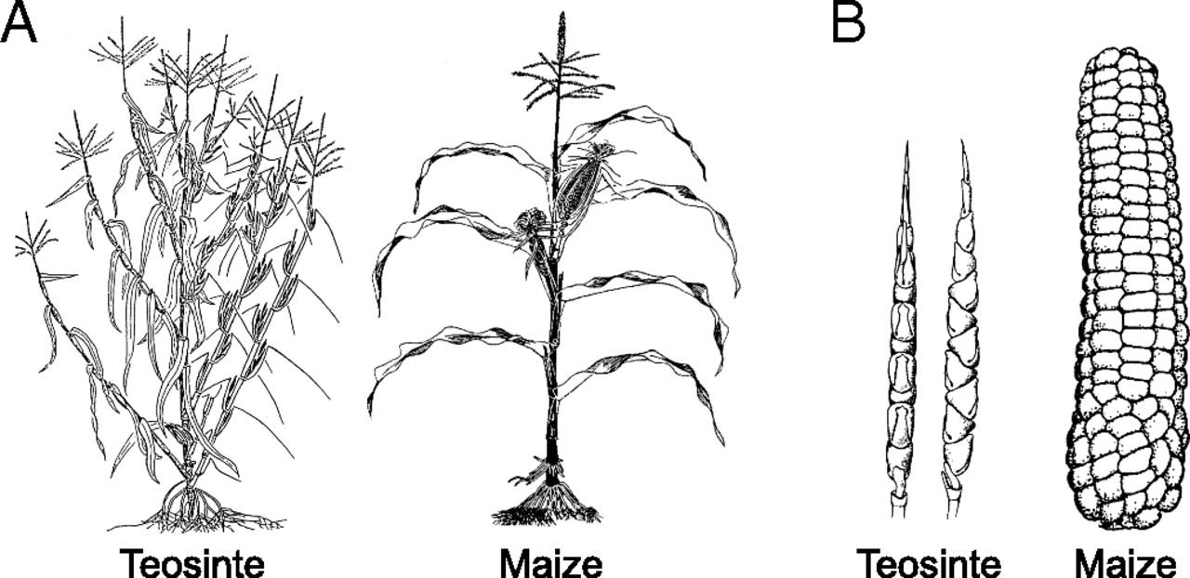
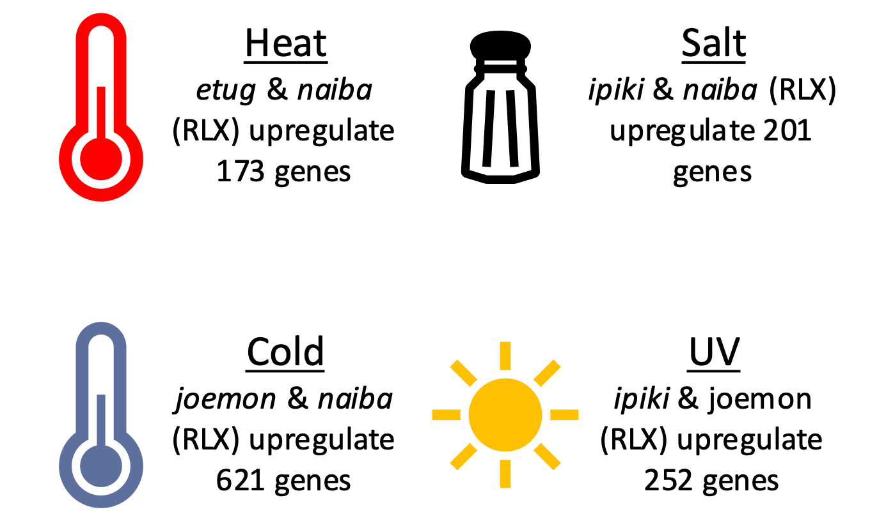
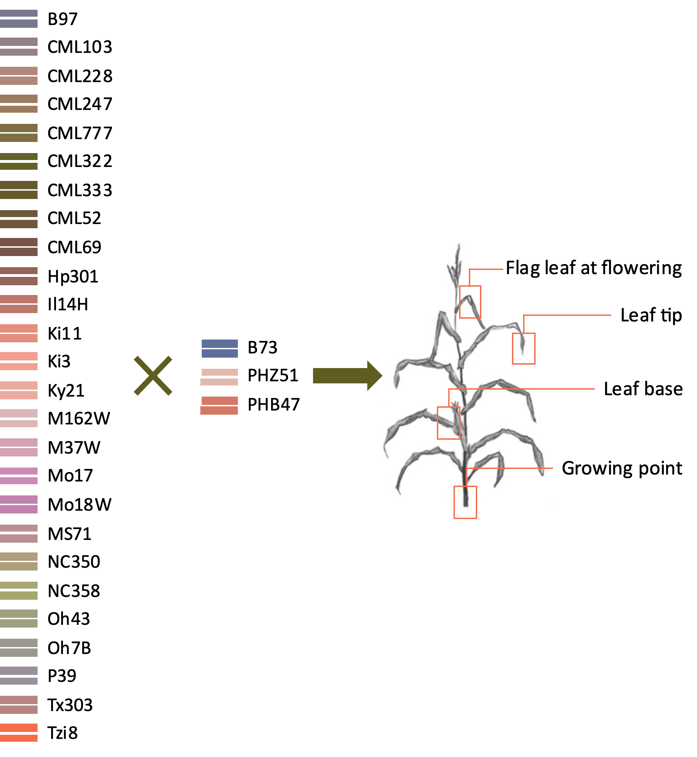
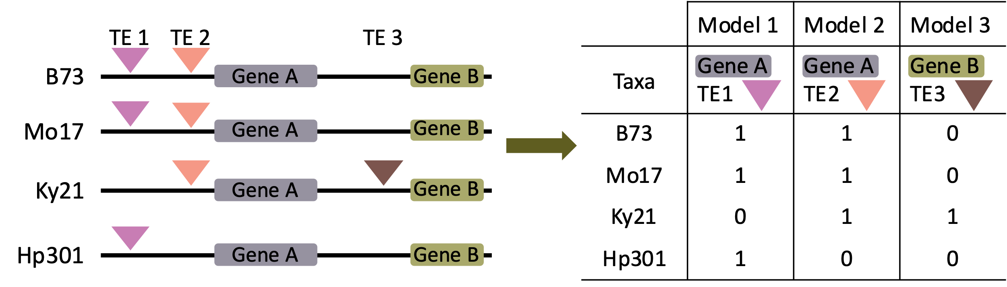
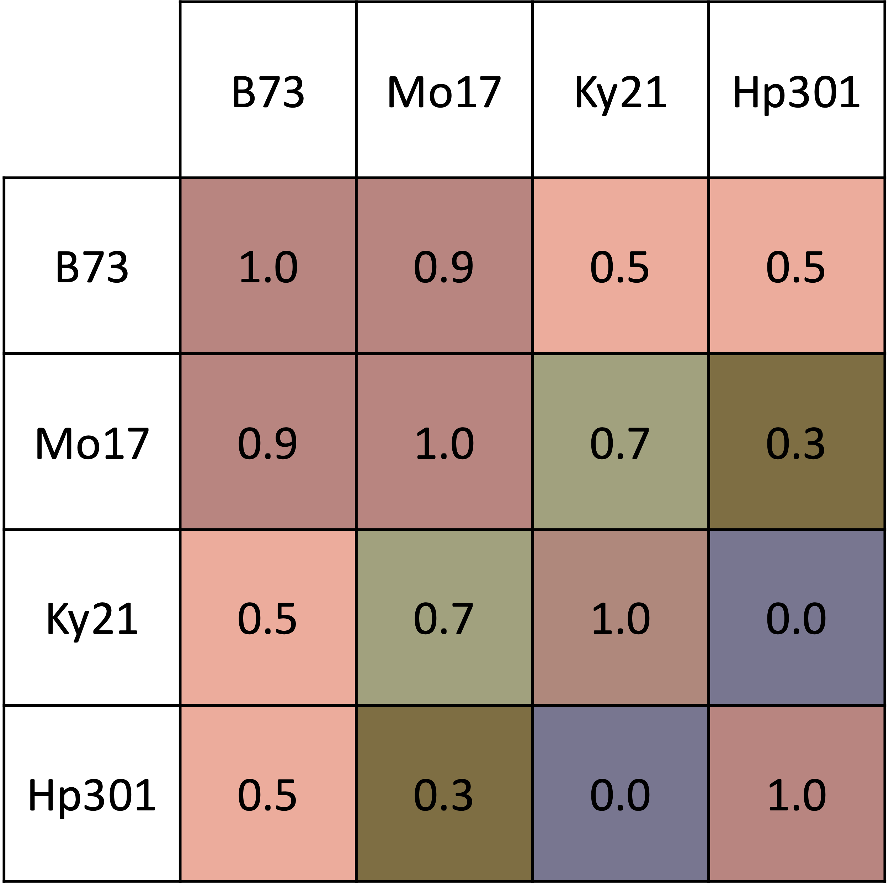
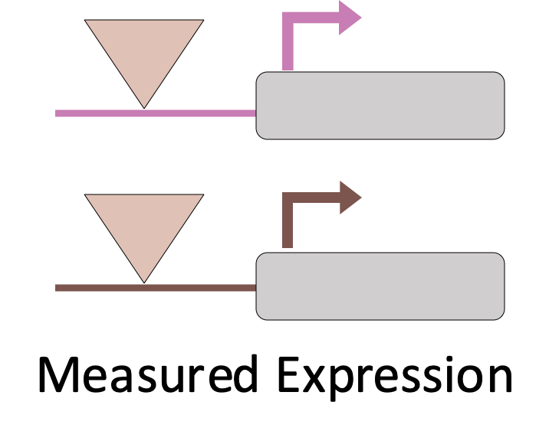

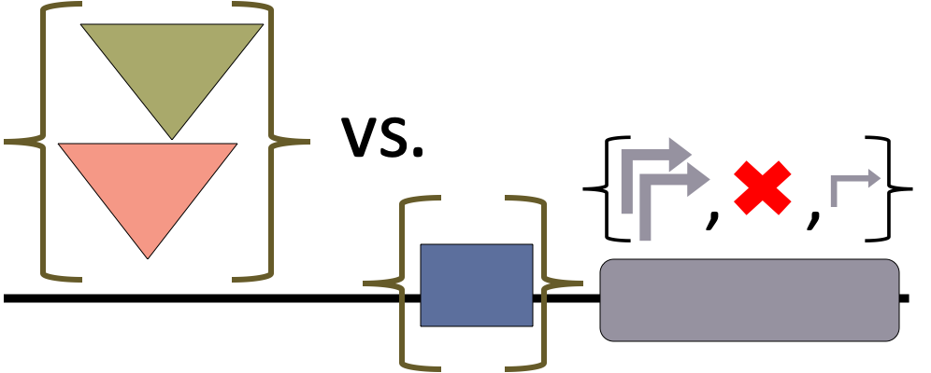
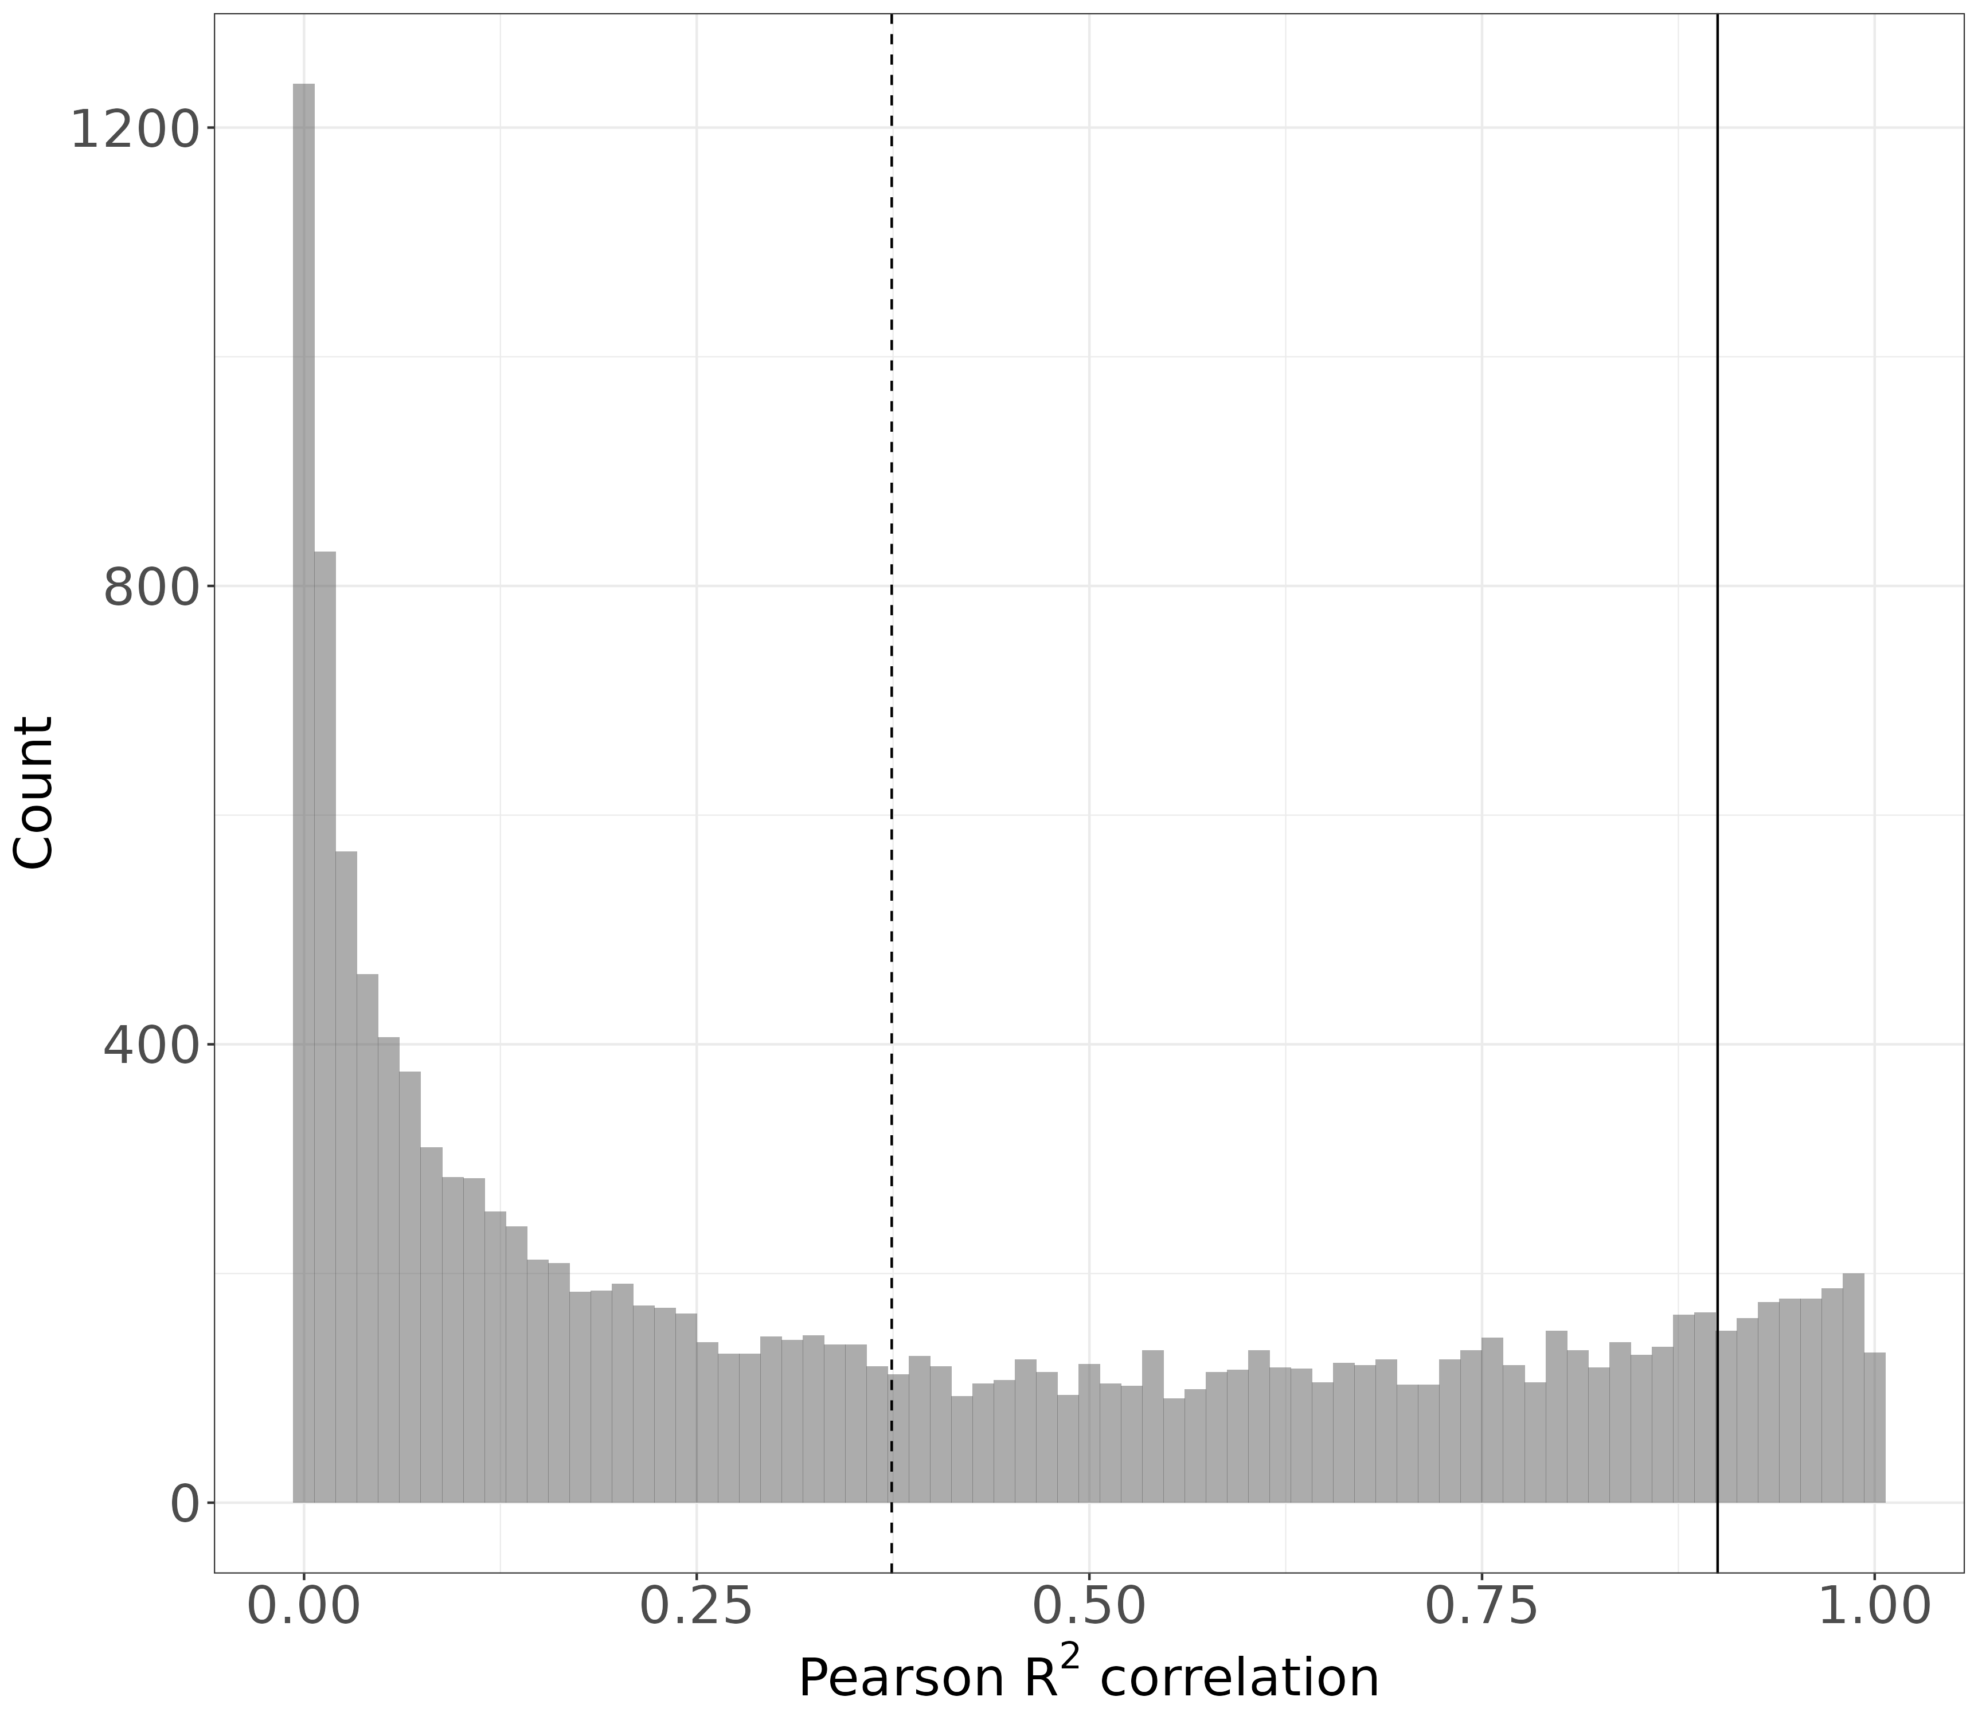
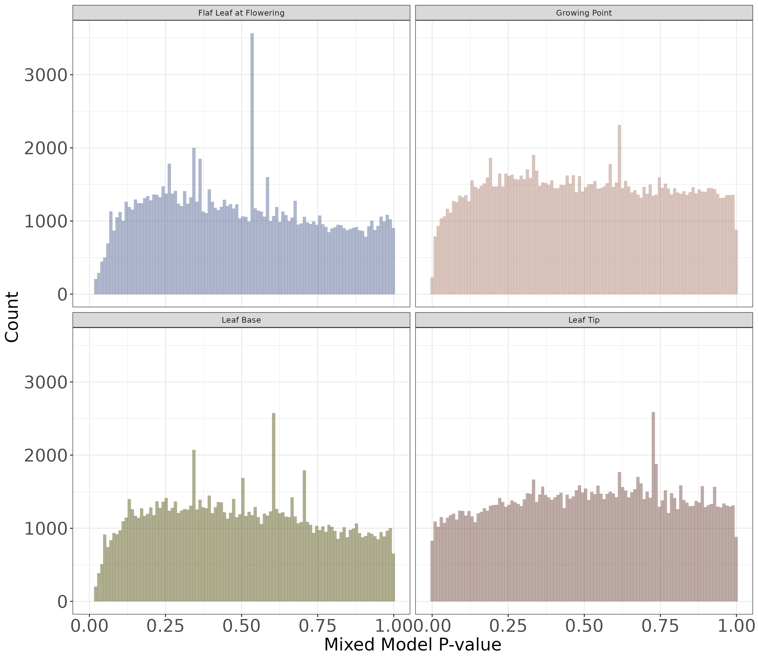
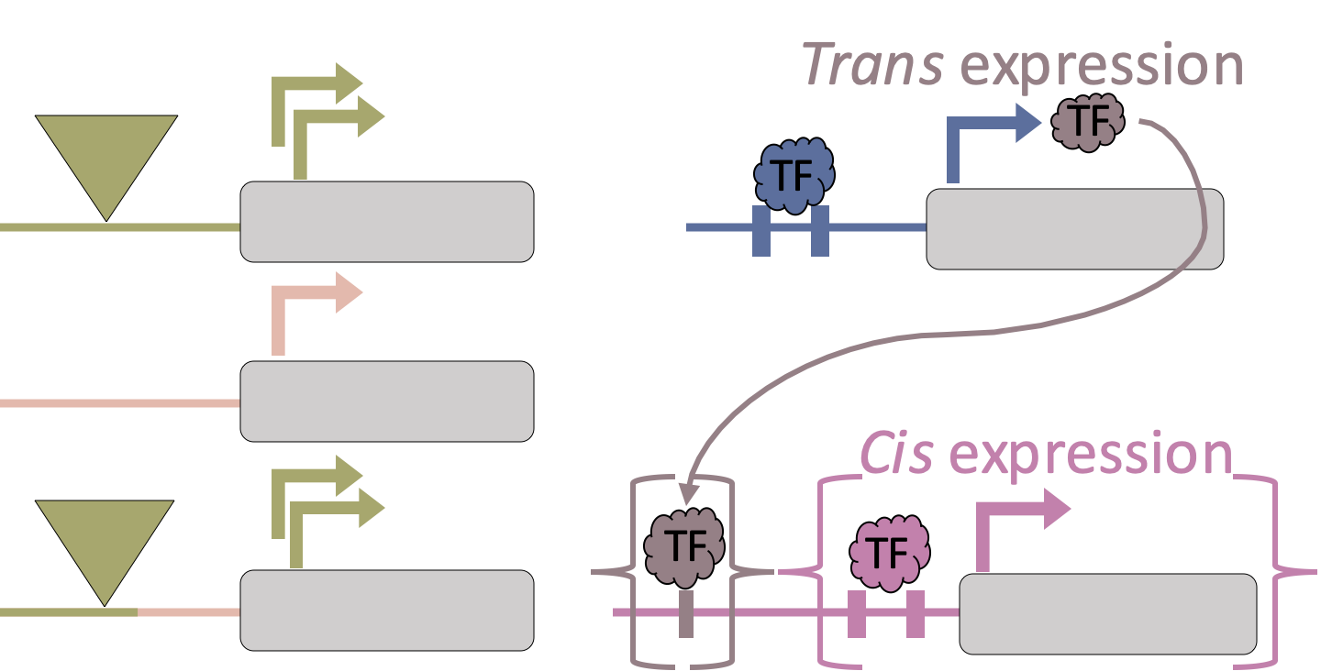
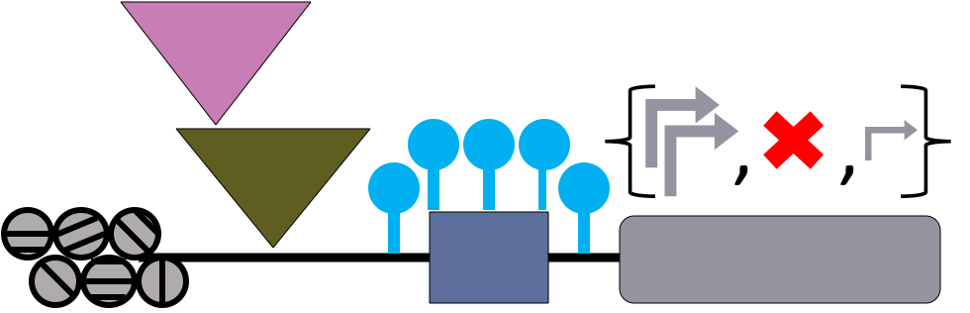


Limited contribution of transposable elements to regulatory adaptation in maize inbreds and hybrids
Merritt Khaipho-Burch¹; Taylor Ferebee²; Cinta Romay³, Michelle Stitzer³; Edward Buckler^{1,3,4}
1) Section of Plant Breeding and Genetics, Cornell University, Ithaca, NY; 2) Department of Computational Biology, Cornell University, Ithaca, NY; 3) Institute for Genomic Diversity, Cornell University, Ithaca, NY; 4) USDA-ARS; Ithaca, NY
@MerKhaiBurch
mbb262@cornell.edu
Transposable element insertions in maize can drastically alter plant phenotypes and gene expression under stress.
Salvi et al., 2007
Yang et al., 2019
Doebley et al., 1997
Makarevitch et al., 2015
Which TEs impact gene expression during normal plant development in maize inbreds and hybrids?
Maize RNA Expression ~ TE Presence or Absence + Maize Kinship
RNAseq Expression Data
TE Presence/Absence Genotypes
Maize Kinship Matrix
Collected and sequenced 372 samples from inbred parents and hybrids.
Accounts for relatedness and linkage disequilibrium between individuals.
Nested Association Mapping (NAM) inbreds
~
+
Lowly related
Highly related
TE and promoter regulatory effects can be separated in a subset of genes. Within those genes, very few TEs impact gene expression.
For 66% of genes (12,668) TE effects are statistically indistinguishable from background SNP and promoter effects due to LD.
For the 34% of genes whose TE effects are not confounded by LD, 5,418 genes and 11,811 associated TEs show some effect on measured expression.
Able to separate TE from maize effects in 34% of genes.
𝜇 = 0.37
Promoter
We will investigate different types of expression estimates in future models.
Relatedness cutoff: R² < 0.9
Allele Specific Expression
Cis/Trans Expression
Plan on identifying biological features contributing to TE-induced gene expression differences.
Correlating kinship matrices calculated from TE sequence vs. background promoter sequence.
Results for only NAM inbred founders shown.
Promoter
Thank you to our funding sources: USDA NIFA AFRI Pre-doctoral fellowship: 2022-67011-36458 and the USDA ARS.
This work was conduced on the traditional homelands of the Gayogo̱hó:nǫ^{Ɂ} (the Cayuga Nation). The Gayogo̱hó:nǫ^{Ɂ} are members of the Haudenosaunee Confederacy, an alliance of six sovereign Nations with a historic and contemporary presence on this land. The Confederacy precedes the establishment of Cornell University, New York state, and the United States of America.

